Slide 1
Transportation Network Company Laws and Regulations
August 31, 2016
Capitol Extension Auditorium

Slide 2
Transportation Network Company Laws and Regulations
Maarit Moran
Texas A&M Transportation Institute
Policy Research Center
Legislative Briefing on TNC Laws and Regulations in Texas and the United States
August 31, 2016

Slide 3

Defining a TNC
A company that provides transportation services using digital technologies that connect passengers to drivers who use their personal vehicles to provide prearranged rides
tti.tamu.edu/policy
Notes:
This is how states laws define TNCs, but note that the definition of TNCs is contentious itself: TNCs claim that they are tech companies, while taxis and critics argue TNCs are illegal vehicles for hire in a highly regulated industry.
TNCs provide on-demand and highly-automated private transportation services.
Texas law: "Transportation network company" means a corporation, partnership, sole proprietorship, or other entity operating in this state that uses a digital network to connect a transportation network company rider to a transportation network company driver for a prearranged ride. The term does not include an entity arranging nonemergency medical transportation under a contract with the state or a managed care organization for individuals qualifying for Medicaid or Medicare.

Slide 4
Ride sourcing, not ride sharing.
TNCs’ primary service is ride sourcing
Ride sharing is carpooling
TNCs do offer shared options
  UberPOOL
  LyftLine
  Split
tti.tamu.edu/policy
Notes:
Moving Ahead for Progress in the 21st Century Act of 2002, Pub. L. No. 112–141, 126 Stat. 405. 2012. http://www.gpo.gov/fdsys/pkg/PLAW-112publ141/pdf/PLAW- 112publ141.pdf. Accessed March 2, 2016.

Slide 5
Background
2012 – Uber, Lyft and Sidecar begin offering services
2014 – Colorado passes first TNC law
2016 (August)
  TNCs operate in 48 states
  Laws passed in 40 states (Includes DC)
tti.tamu.edu/policy

Slide 6
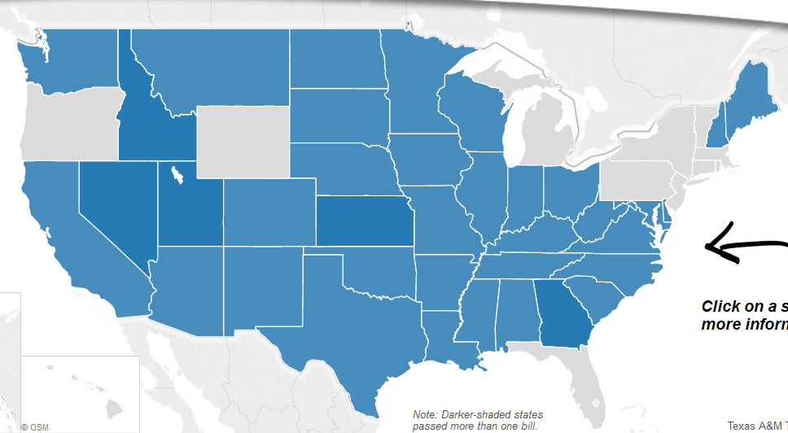
State-Level TNC Legislation
http://tti.tamu.edu/policy/technology/tnc-legislation/
tti.tamu.edu/policy
Notes:
Map link: http://tti.tamu.edu/policy/technology/tnc-legislation/
The emergence of TNCs --- questions about their legal status, public safety concerns, and criticism from the taxi industry. This has led to legislative activity across the country.
We are tracking every state’s legislative activity. And we created this map to publish and share this information as it is changing. The map shows, in blue, the states that have passed some kind of TNC law. You can then click or hover over each state, to see a short summary of legislative action and a link to the actual bill text.

Slide 7
Policy Areas in TNC Laws
7 Policy Areas, 31 Policies
  Permits and fees
  Insurance and financial responsibility
  Driver and vehicle requirements
  Operational requirements
  Passenger protections
  Data reporting
  Regulatory and rule-making authority
tti.tamu.edu/policy
Notes:
Among the 35 states reviewed in our policy brief, I reviewed each bill and identified a set of policy issues addressed in each. I identified seven policy areas addressed by the bills.

Slide 8
Policies in State TNC Laws
Out of 31 policies reviewed:
No state included every policy
Nevada has 24 (most)
Texas has 4 (insurance)
Washington has 3 (fewest)
tti.tamu.edu/policy

Slide 9
Most Common State Policies
Define companies as TNCs (30 states)
Requirements for:
  Insurance (35 states)
  Minimum driver age, license, registration (30 states)
  Background check (30 states)
  Rates and fares disclosure (27 states)
tti.tamu.edu/policy
Notes:
TCRP 75: insurance was found to be the most widely regulated aspect of PHVs as well.
Most state TNC laws included requirements for: insurance coverage, driver….

Slide 10
Permits and Fees
Require TNC Permit (24 states)
  $500 to $111,250
Taxes or other fees
  Nevada – 3% excise tax
  Rhode Island – 7% sales tax
  Massachusetts – 20 cent per ride fee
tti.tamu.edu/policy
Notes:
Permits (24 states): Fees range from $500 in Montana, to 111,000 in Colorado.
Specify fund (7 states)
Require license for driver (5 states)

Slide 11
Insurance &
Financial Responsibility
Insurance requirements (35 states)
Texas HB 1733 (effective Jan. 2016)
  Require insurance for TNC and TNC driver
  TNC driver must have proof of insurance while operating
  Disclose to TNC driver certain limitations of coverage
tti.tamu.edu/policy
Notes:
Four states passed bills in 2015 that focused, almost exclusively, on insurance requirements: Minnesota, Louisiana, Washington, and Texas. TNCs always had some insurance, there were concerns about gaps.
Source: HB 1733, effective January 1, 2016
The law requires the following:
• TNC drivers must have primary automobile insurance that allows them to operate as TNC drivers. The TNC, TNC driver, or a combination can maintain the automobile insurance.
• When a TNC driver is logged in but not yet engaged in a ride (“between” rides), insurance must provide:
o Minimum liability coverage of:
▪ $50,000 for bodily injury/death per person per incident.
▪ $100,000 for bodily injury/death per person per incident.
▪ $25,000 for damage to or destruction of property of others per incident.
o Uninsured/underinsured motorist coverage as required by Texas insurance code.
o Personal injury protection coverage as required by Texas insurance code.
• From the time a driver accepts a ride until the passenger departs (“engaged” in ride), insurance must provide minimum coverage of:
o $1 million total liability for death, bodily injury, and property damage per incident.
5
o Uninsured/underinsured motorist coverage as required by Texas insurance code.
o Personal injury protection coverage as required by Texas insurance code.
8 states mention employee classification or workers comp, but often its just to state what does or does not count. Two states (indiana and Ohio) explicitly write into the bill that TNC drivers are not employees. Other states leave it open. TNCs are facing law suits about this and from an economic/labor standpoint it is still a key issue.

Slide 12
Insurance &
Financial Responsibility
Drivers’ employment status (8 states)
  Ohio and Indiana write drivers are not employees
  Other states provide criteria for what makes an “employee” or leave open to rule-making
Alaska found Uber in violation of workers compensation act; Uber suspended service
tti.tamu.edu/policy

Slide 13
Driver & Vehicle Requirements
Background check (30 states)
  No state requires fingerprint-based background checks, though some cities do
  Kansas and Nevada enacted and subsequently removed fingerprint-based background checks
tti.tamu.edu/policy
Notes:
Background checks vary in who conducts it, what databases are reviewed, violations that disqualify drivers. A point of contention has been fingerprint-based

Slide 14
Operational Requirements
No street hails (23 states)
  Differentiates TNCs from taxis
No cash payments (16 states)
  Only Ohio allows cash payments
  TNCs currently do not take cash
tti.tamu.edu/policy
Notes:
Safety, serve to differentiate what taxis do and what TNCs do. And the use of the app for hailing TNC rides can have a safety benefit because passengers are linked to the vehicle.

Slide 15
Passenger Protections
Provide opportunity to request wheelchair accessible ride (18 states)
Limitations on disclosing passenger personally identifiable information (12 states)
tti.tamu.edu/policy
Notes:
Non discrimination – TNC needs to have a policy. They commonly mention that TNCs must comply with other existing laws, like accomodating service animals,
PII: TNCs may not disclose a passenger’s PII to a third party, except in certain circumstances including:
• The customer knowingly consents.
• It is required by law.
• It is needed to investigate a complaint or violation against a TNC or TNC driver (41).

Slide 16
Data Reporting
Retain driver and trip records (22 states)
Additional reporting requirements (5 states)
  Wheelchair ride requests
  Jurisdictions where TNC operates
  Crashes, traffic violations
tti.tamu.edu/policy
Notes:
Records of each driver and each trip – commonly for one year, up to 6 years.
For example, North Dakota requires a TNC to provide reports every six months that include (42):
• The jurisdictions in which the TNC operates.
• The number of reported accidents while passengers were in the vehicle.
• The number and types of reported traffic violations and any other violations while passengers were in the vehicle.

Slide 17
Regulatory & Rule-Making
Authority
Preemption of local authority (21 states)
  Cities may not tax, license, rule
  South Dakota bill requires insurance but allows municipalities to rule on operations
tti.tamu.edu/policy

Slide 18
Texas City-Level TNC Ordinances
14 cities enacted TNC ordinances (through August 2016)
Address similar policy areas as state-level legislation
tti.tamu.edu/policy

Slide 19
Texas City-Level TNC Policies
Do not address worker status
Dynamic pricing
  Disclose dynamic pricing (6 cities)
  Limit dynamic pricing in emergency (4 cities)
Vehicle age restriction (4 cities)
Minimize travel distance (2 cities)
tti.tamu.edu/policy
Notes:
Address many of the same policies as State-level
Dynamic pricing was only mentioned in 1 state, but here it is in 6 cities.
Vehicle age – in cities where U/L have suspended operations and Houston.

Slide 20
Background Checks in Cities
Houston, Corpus Christi, Austin require fingerprint-based checks
  Austin has 8 TNCs in compliance with ordinance requirements
  San Antonio – optional fingerprint check
  NYC – imposes fingerprint checks on TNCs
tti.tamu.edu/policy
Notes:
Corpus included fingerprint checks, Uber and Lyft left. Two TNCs currently operate. http://www.101corpuschristi.com/news/4750
Austin
Uber and Lyft suspended operations in May 2016
8 TNCs operate in compliance with the law, all met August 1 requirement of 50% compliance with fingerprint checks.
https://communityimpact.com/austin/employment/2016/08/24/lyft-uber-schedule-meetings-with-austin-city-council-members/
Corpus Christi – Uber left, 2 TNCs currently operate
Houston – Uber in compliance, Getme
NYC – Uber, Lyft, other TNCs in compliance

Slide 21
New Developments in Texas
Passed ordinances since May 2016
  El Paso
  Fort Worth
  Lubbock
  Odessa
  New Braunfels
Revised previous ordinance
  Midland
Upheld current TNC ordinance
  Austin voters rejected a referendum that would have eliminated fingerprint checks
tti.tamu.edu/policy
Notes:
Odessa – May 10, ordinance similar to Midland.
Not an exhaustive list of where TNCs operate without an ordinance

Slide 22
Future Policy Considerations
Evolving TNC services
  Ride splitting, food delivery, carpool
  Partnering with transit to fill service gaps
Emerging TNCs
  At least 8 TNCs now operate in Texas
Autonomous shared vehicles?
  Driver employment
  Safety and security
tti.tamu.edu/policy
Notes:
TNCs are still expanding and evolving
TNCs adjust to local conditions (market, regulations, needs)
Different services – matter because it is not clear yet where the industry is going.
All of these will have implications for how and what can be regulated.

Slide 23
Map: http://tti.tamu.edu/policy/technology/tnc-legislation
Report: http://tti.tamu.edu/documents/PRC-2016-1.pdf
Thank you.
Maarit Moran
Associate Transportation Researcher
Texas A&M Transportation Institute
m-moran@tti.tamu.edu
512-407-1130
tti.tamu.edu/policy

Slide 24
Sources
Shared-Use Mobility Center. Shared-Use Mobility Reference Guide. 2015. http://sharedusemobilitycenter.org/wp-content/uploads/2015/09/SharedUseMobility_ReferenceGuide_09.25.2015.pdf. Accessed July 6, 2016.
Part 6 of Article 10.1 of Title 40, C.R.S., Colorado. 2014. http://www.legispeak.com/bill/2014/sb14-125. Accessed July 1, 2016.
Smith, Aaron. Shared, Collaborative and On Demand: The New Digital Economy. Pew Research Center, May 19, 2016. http://www.pewinternet.org/2016/05/19/on-demand- ride-hailing-apps/. Accessed June 22, 2016.
http://greatergreaterwashington.org/post/25405/the-ap-bans-the-term-ride-sharing-for-uber-lyft/
http://www.bna.com/uber-lyft-transporting-n73014445690/
tti.tamu.edu/policy

Slide 26
State-Level TNC Legislation
Since May 2016
  Alabama
  Delaware (replaced MOU with bill)
  Massachusetts
  Missouri
  New Hampshire
  Rhode Island
tti.tamu.edu/policy
Notes:
Chart of new states by year?
2014: 3 states
2015: 25?
2016: 12

Slide 27
Other TNC Services
Ride-sharing/pooling/splitting
Carpooling
Food delivery
Taxi e-hailing
Rides for women and kids
Non-emergency medical trips
Trip-chaining, flat fares, unlimited pass
tti.tamu.edu/policy
Notes:
TNCs are still evolving and piloting different services. Lyft is introducing services to reserve rides without a smartphone, an app function to add a stop to a ride, Uber has facilitated helicopter rides.

Slide 28
Context
In 6 years, Uber has 2 billion rides
In 6 days, Americans take 6.6 billion trips
15% in U.S. used TNCs, 33% never heard of it (Pew survey)
tti.tamu.edu/policy
Notes:
Source: 3

Slide 29
Other For-Hire Definitions
Private for-hire vehicles (PHV)
  Provide surface transportation for passengers;
  Are owned and operated by private, for-profit firms; and
  Generate revenues through fares, scrip, or contracts”
Taxicab. A PHV providing point-to-point, on-demand, passenger service.
Livery. A PHV, taxi-like service operated on a prearranged basis.
tti.tamu.edu/policy
Notes:
(8) Gilbert, G., T. J. Cook, A. Nalevanko, and L. Everett-Lee. TCRP Report 75: The Role of the Private-for-Hire Vehicle Industry in Public Transit. Transit Cooperative Research Program, Transportation Research Board of the National Academies, Washington, D.C., 2002. http://onlinepubs.trb.org/onlinepubs/tcrp/tcrp_rpt_75.pdf. Accessed July 1, 2016.

Slide 30
Research Next Steps
  Continued tracking state TNC bills
  Legal review of Texas Code
  TNC v. taxi regulation
  More in-depth case studies
    Transit partnerships
    Suburban application
    Rural application
tti.tamu.edu/policy

